Slide 1
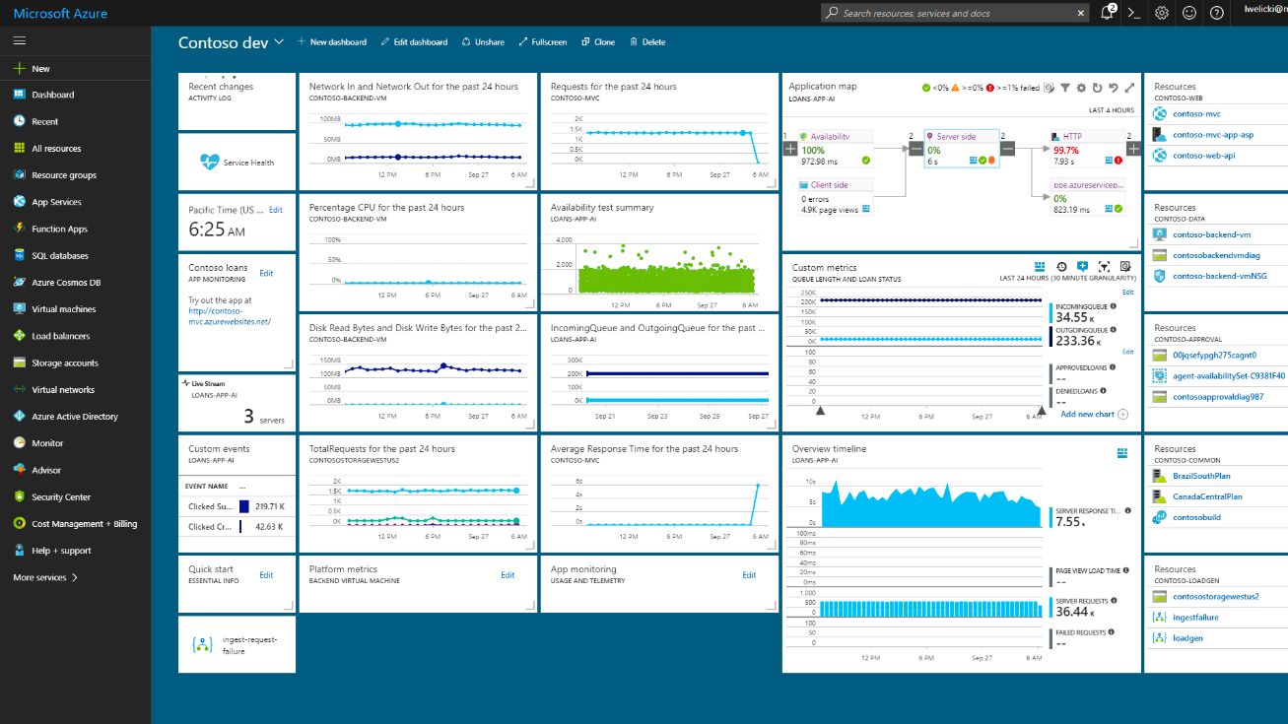
Azure University Tour
University of Washington
April 17, 2018
10:45AM – 11:00AM | Registration and check-in
11:00AM – 12:15PM | Keynote presentation with Azure demos & use case stories
12:15PM – 12:35PM | Break
12:35PM – 2:05PM | Hands-on challenges

Slide 2


Slide 3

Jeff Sandquist
General Manager, Azure Ecosystem
@jeffsand

Slide 4
Opportunity
Notes:
We live in an technology era of boundless opportunity.
Quantum Computing.
Near infinite compute power.
Near infinite data storage.
The ability to solve problems using artificial intelligence and machine learning that weren't possible just a few years ago.
The ability to build virtual reality experiences that connect and empower the world.
The knowledge and acceptance that technology will affect every industry and unlock opportunity everywhere.
It's an incredible time to be alive and in our industry.

Slide 5
Responsibility
Notes:
The future is yours.
Each of you will get the chance to shape the future you live in.
The opportunity is clear, and we just talked about that.
But as an industry, your predecessors have all too often emphasized opportunity at the expense of responsibility.
You can see this choice in the headlines every day. But what if it wasn't a choice?
What if we all accepted that we must balance seizing the opportunities that lie ahead with the responsibility to shape the future.
To shape a future where people of all socio-economic and demographic backgrounds share in that opportunity.
To shape a future where technology augments the human experience, not replaces it.
To shape a future where technology levels the playing field and affords everyone access to its benefits.
That future is yours to create.

Slide 6
Timeless values and principles
Opportunity & Responsibility
Notes:
Our mission at Microsoft is to empower every person and every organization on the planet to do more. We are here to help you seize this opportunity, and we are committed to earning your trust and acting responsibly in our industry.

Slide 7

Paige Bailey
Cloud Developer Advocate
@DynamicWebPaige

Slide 8




How do I create intelligent apps without knowing how to build a neural network?
AI Services
TRAINED SERVICES
CONVERSATIONAL UI
LANGUAGE
Azure Cognitive Services
Bot Framework
LUIS
AI Infrastructure
AI ON DATA
Microsoft SQL Server
Notes:
You don’t have to be an expert coder to start building intelligence into your solutions.
AI services: Use these high-level services to add intelligence to your apps.
With Cognitive Services, you can leverage pre-built intelligent algorithms to see, hear, speak, understand, and interpret users’ needs through natural methods of communication. https://azure.microsoft.com/en-us/services/cognitive-services/
With an intelligent back end like Language Understanding Intelligent Service (LUIS) and the Bot Framework, you can build, connect, deploy, and manage conversational AI for intelligent bots with Azure Bot Service to interact naturally with users on websites and in apps. https://dev.botframework.com/
LUIS allows you to recognize meaning from natural language so users can use natural language to interact with your apps https://www.luis.ai/
AI infrastructure
SQL Server provides you with storage for your data https://docs.microsoft.com/en-us/azure/sql-database/

Slide 9







Azure Cognitive Services are ready to go pre-trained models
Vision
From faces to feelings, allow your apps to understand images and videos
Speech
Hear and speak to your users by filtering noise, identifying speakers, and understanding intent
Language
Process text and learn how to recognize what users want
Knowledge
Tap into rich knowledge amassed from the web, academia, or your own data
Search
Access billions of webpages, images, videos, and news articles with the power of Bing APIs
Labs
An early look at emerging Microsoft Cognitive Services technologies: discover, try, and give feedback on technologies before general availability
Notes:
Cognitive Services is actually an entire suite of intelligent APIs, so you can analyze video, images, voice, language, gestures and more.
It takes just a few lines of code to enable each API in your app and since you are just calling an API you can call it from the programming language of your choice.
These services are built and supported by Microsoft. Many of them are used in our own products.
https://azure.microsoft.com/en-us/services/cognitive-services/
Vision: Image-processing algorithms to smartly identify, caption, and moderate your pictures
Computer Vision: Distill actionable information from images
Content Moderator: Automatically moderate potentially offensive images, text, and videos
Customer Vision Service: Train a web service to recognize specific content in images
Face: Identify human faces and emotions in images
Video Indexer: Easily extract insights from your videos to enrich your applications
Speech: Convert spoken audio into text, use voice for verification, or add speaker recognition to your app
Bing Speech: Convert speech to text and text to speech
Speaker Recognition: Use speech to identify and authenticate individual speakers
Custom Speech Service: Overcome speech-recognition barriers like speaking style, background noise, and vocabulary
Translator Speech: Easily conduct real-time speech translation on your app
Language: Enable your apps to process natural language with pre-built scripts, evaluate sentiment, and learn how to recognize what users want
Bing Spell Check: Add spell checking functionality to your app
Language Understanding Intelligent Service (LUIS): Add language understanding intelligence to your apps with minimal effort
Linguistic Analysis: Easily parse complex text with language analysis
Text Analytics: Easily evaluate sentiment, language, and key phrases to understand what users want
Translator Text: Easily conduct machine translation for 60+ languages
Knowledge: Map complex information and data in order to solve tasks such as intelligent recommendations and semantic search
Knowledge Exploration Service: Enable interactive search experiences over structured data via natural language inputs
Entity Linking Service: Power your app's data links with named entity recognition and disambiguation
Academic Knowledge: Tap into the wealth of academic content in the Microsoft Academic Graph using the Academic Knowledge API
QnA Maker: Distill information into an easy-to-navigate frequently-asked-questions (FAQ) document for bot services
Customer Decision Service: Create custom experiences with adaptive, contextual decision-making
Search: Add Bing Search APIs to your apps and harness the ability to comb billions of webpages, images, videos, and news articles with a single API call
Bing Autosuggest: Give your app intelligent autosuggest options for searches
Bing News Search: Search for news and get comprehensive results
Bing Web Search: Get enhanced search details from billions of web documents
Bing Entity Search: Enrich your experiences by identifying and augmenting entity information from the web
Bing Image Search: Search for images and get comprehensive results
Bing Video Search: Search for videos and get comprehensive results
Bing Custom Search: Create tailored site search or vertical search experiences for topics you care about
Labs: Cognitive Services Labs are early-preview limited-availability leading innovation APIs and SDKs that allow developers to start experimenting with Microsoft’s latest and greatest Cognitive Services
Project Prague: SDK to incorporate gesture-based controls into your apps. Quickly define and implement customized hand gestures, creating a more natural user experience; limited private preview availability at launch
Project Cuzco: API to help developers find events associated with Wikipedia entities; begin with a Wikipedia entity and receive a list of related events organized by time
Project Johannesburg: API to calculate route logistics for deeper location intelligence to account for specific enterprise requirements; for example, weight, height, length, hazardous materials, and so on
Project Nanjing: API to calculate isochrones—time and distance-based recommendations for enterprise route optimization
Project Abu Dhabi: API to create distance matrices, enabling you to calculate a histogram of travel times and serve as a stepping stone for enterprise route optimization
Project Local Insights: API to help “score” the attractiveness of a location, based on how many of a particular amenity are within a specific distance; for example, restaurants, parks, and transit stops

Slide 10





What if I want to train my own models?
AI Tools
Azure Machine Learning Studio
Azure ML Workbench
Azure Notebooks
AI Infrastructure
AI ON DATA
AI COMPUTE
Azure Data Lake
Microsoft SQL Server
Azure Cosmos DB
Data science virtual machine (DSVM)
Notes:
Maybe you have already started learning python Pandas and tools like Sci kit learn to train your own models. If so you can use those existing skills to train machine learning in the cloud.
AI infrastructure:
Tools like Azure Data Lake allow you to query and access data from multiple data sources to train your models https://azure.microsoft.com/en-us/solutions/data-lake/
The Data Science Virtual Machine saves you time with pre-installed tools (more on the next slide) https://azure.microsoft.com/en-us/services/virtual-machines/data-science-virtual-machines/
SQL Server provides storage for relational data https://docs.microsoft.com/en-us/azure/sql-database/
Azure Cosmos DB is Microsoft's globally distributed, multi-model database. With the click of a button, Azure Cosmos DB enables you to elastically and independently scale throughput and storage across any number of Azure's geographic regions. https://docs.microsoft.com/en-us/azure/cosmos-db/introduction
AI tools:
Azure Machine Learning studio is a drag and drop interface and also supports custom Python and R code https://studio.azureml.net/
Azure ML Workbench allows you to write your own Python code to train models https://docs.microsoft.com/en-us/azure/machine-learning/preview/quickstart-installation
Azure notebooks provides you with an execution environment for Python 2, Python 3, F# and R. https://notebooks.azure.com/

Slide 11
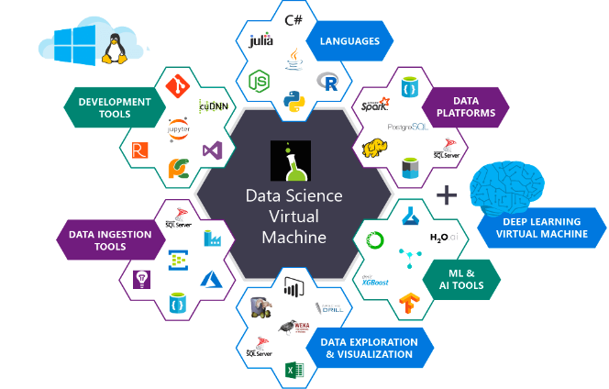
The Data Science Virtual Machine comes
pre-loaded with the open source you need
Running an image processing pipeline in a DSVM with deep learning products pre-installed
Notes:
If you want to build your own solutions, you can save time installing tools with the Data Science Virtual Machine:
The Data Science Virtual machine provides big data, data analytics, and machine learning tools in one pre-configured, ready-to-use environment,.
An Ubuntu image is available, a CentOS image is available, and a Windows image is available. The exact components installed vary depending on the operating system.
You can choose many different sizes and configurations for your virtual machine – some have GPU or CPU/RAM configurations optimized for specific types of Deep Learning tasks including Image Recognition.
Visual Studio and the Azure SDK come pre-installed along with language packs making it easy to use R, Python, SQL, or C#.
Tools installed on the image may include (depending on the operating system selected):
Azure Machine Learning Workbench
Microsoft ML Server Developer Edition
Anaconda Python distribution
Microsoft R Server 9.2.1 with Microsoft R Open 3.4.1, MicrosoftML package with machine learning algorithms, RevoScaleR and revoscalepy for distributed and remote computing, and R and Python Operationalization
Jupyter Notebook (with R, Python, PySpark kernels)
Visual Studio Code, IntelliJ IDEA, PyCharm, and Atom
Power BI desktop
SQL Server 2017 Developer Edition
Single node local Hadoop
Standalone Spark instance for local development and testing
Azure command-line interface
H2O, Deep Water, and Sparkling Water
JuliaPro
Intel Math Kernel Library
xgboost for gradient boosting
Machine learning and Data Analytics tools
Deep Learning Frameworks: A rich set of AI frameworks including Microsoft Cognitive Toolkit, TensorFlow, Chainer, Apache MXNet, Keras are included on the VM.
Vowpal Wabbit: A fast machine learning system supporting techniques such as online, hashing, Allreduce, reductions, learning2search, active, and interactive learning.
XGBoost: A tool providing fast and accurate boosted tree implementation.
Rattle (the R Analytical Tool To Learn Easily): A tool that makes getting started with data analytics and machine learning in R easy, with GUI-based data exploration, and modeling with automatic R code generation.
Weka : A visual data mining and machine learning software in Java.
Apache Drill: A schema-free SQL Query Engine for Hadoop, NoSQL and Cloud Storage. Supports ODBC and JDBC interfaces to enable querying NoSQL and files from standard BI tools like Power BI, Excel, Tableau.
Libraries in R and Python for use in Azure Machine Learning and other Azure services
Git including Git Bash to work with source code repositories including GitHub, Visual Studio Team Services
Windows ports of several popular Linux command-line utilities (including awk, sed, perl, grep, find, wget, curl etc) accessible through command prompt.
Learn more about the Data Science Virtual Machine

Slide 12






Are you ready for deep learning?
AI Tools
Microsoft Visual Studio Code Tools for AI
Azure Notebooks
AI Infrastructure
DEEP LEARNING FRAMEWORKS
AI ON DATA
AI COMPUTE
Azure Data Lake
Microsoft SQL Server
Azure Cosmos DB
Apache Spark
Data science virtual machine (DSVM)
Batch AI
AKS
Microsoft Cognitive Toolkit
Tensorflow
Caffe2
Notes:
The cloud allows a great deal of computing power to enable deep learning scenarios. Deep learning requires specialized tooling.
Azure supports a number of open source technologies and some proprietary tools to support deep learning.
AI infrastructure:
Open source tools like Apache spark are supported on Azure https://azure.microsoft.com/en-us/services/hdinsight/apache-spark/
Batch AI allows you to train models on clusters of virtual machines https://azure.microsoft.com/en-us/services/batch-ai/
Azure Container Service can help you manage your Kubernetes environment https://azure.microsoft.com/en-us/services/container-service/
AI tools:
Microsoft Visual Studio Code Tools is a cross-platform extension that supports deep learning frameworks including Microsoft Cognitive Toolkit (CNTK), Google TensorFlow, Theano, Keras, Caffe2 and more. You can use additional deep learning frameworks via the open architecture. Visual Studio Code Tools for AI leverages existing code support for Python, C/C++/C#, and supplies additional support for Cognitive Toolkit BrainScript.for AI https://www.visualstudio.com/downloads/ai-tools-vscode/
Azure notebooks provides you with an execution environment for Python 2, Python 3, F# and R. https://notebooks.azure.com/
Azure supports open source tools like Tensorflow and Caffe for deep learning https://docs.microsoft.com/en-us/visualstudio/ai/tensorflow-vm ; https://docs.microsoft.com/en-us/azure/hdinsight/spark/apache-spark-deep-learning-caffe
Cognitive Toolkit trains and evaluates deep learning algorithms faster than other available toolkits, scaling efficiently in a range of environments—from a CPU, to GPUs, to multiple machines—while maintaining accuracy. https://www.microsoft.com/en-us/cognitive-toolkit/

Slide 13
Put it all together and you have everything you need to build on your terms
AI Services
AI Tools
TRAINED SERVICES
CONVERSATIONAL UI
LANGUAGE
Azure Machine Learning Studio
Azure ML Workbench
Microsoft Visual Studio Code Tools for AI
Azure Notebooks
Azure Cognitive Services
Bot Framework
LUIS
AI Infrastructure
DEEP LEARNING FRAMEWORKS
AI ON DATA
AI COMPUTE
Azure Data Lake
Microsoft SQL Server
Azure Cosmos DB
Apache Spark
Data science virtual machine (DSVM)
Batch AI
AKS
Microsoft Cognitive Toolkit
Tensorflow
Caffe2
Notes:
Together this provides a comprehensive suite of tools for data science in the cloud.

Slide 14
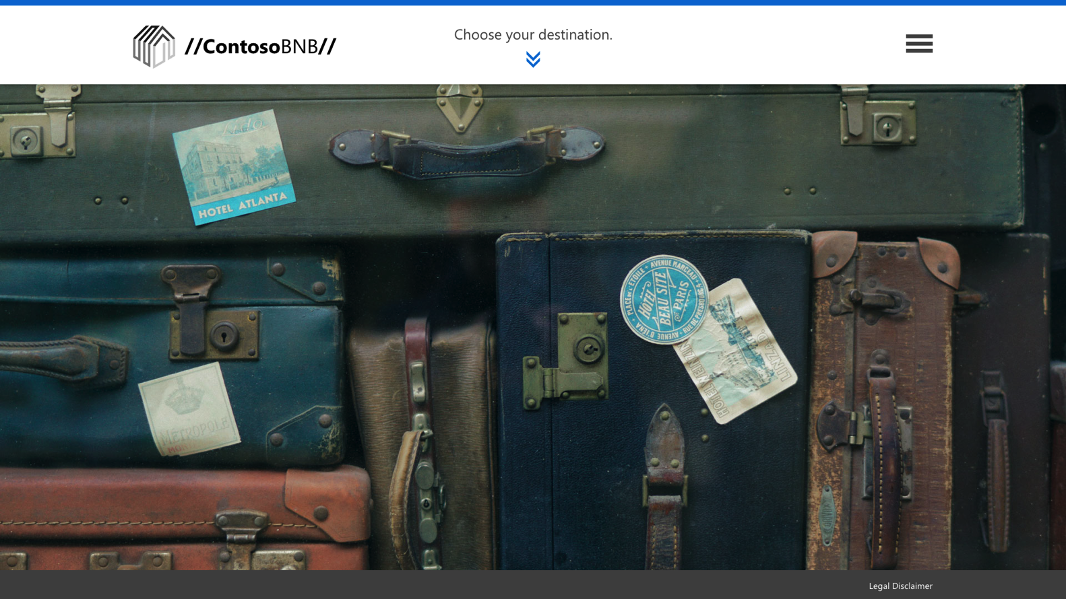
ContosoBNB app: The trip-rental app that learns with you and works for you
Notes:
Data science allows you to add intelligence to your applications.
The Contoso BNB app shows you how you can add intelligence to a vacation rental application
You can download the code and deploy this website yourself at https://aka.ms/azureuniversitytour
Then try the following steps to see how intelligence results in a better user experience
Navigate to your deployed ContosoBNB website.
Today’s Bed And Breakfast apps list all rentals in a city but don’t allow you to identify which neighborhoods are best for you based on what you can find nearby.
Click Choose your destination
Click Seattle, WA
You see a map with a circle in each neighborhood. The number in each circle indicates the number of rentals in that neighborhood.
Check out the legend: The color of the circle ranks each neighborhood based on your preferences. The bright blue circle is the best match.
If you want to find a neighborhood with lots of parks nearby.
Click Make it Yours to specify what you want in a neighborhood
Change Parks & Recreation to Very Important. Set everything else to Not Important
Click Find Your Neighborhood.
The application will now highlight with a bright blue circle the neighborhood with the closest parks & recreation facilities
Try different combinations and see how the application helps the renter figure out the ideal neighborhood
Click Make it Yours to specify what you want in a neighborhood
Change the settings
Click Find Your Neighborhood to see the results
We are using the Cognitive Service Project Local Insights to identify the best neighborhood. We picked 5 search criteria, but the service allows you to pick other services as well, you could pick prioritize based on nearby attractions, Pet supply stores and more. In fact if you try the web challenge at https://aka.ms/azureuniversitytour you can try that for yourself!
Once you find your perfect neighborhood, find out which rentals in that neighborhood best meet your needs.
1. Hover over one of the neighborhoods and click on the pop up comment next to it.
2. When you look at the listings for each rental, you see a “Perfect Match” score that indicates its proximity to the features you selected
3. You will also see a happy or sad face beside the ratings. This happy or sad face is determined based on sentiment analysis of the reviews.
Not only have we made a better rental site for travelers, we made a better experience for people listing their properties
One of the challenges everyone renting a property has to deal with is figuring out how much to charge!
1. Click on the hamburger menu and select List a Room.
Scroll to the bottom of the screen. You will see an Optimized Rental Rate.
Suggested rate per night
Suggested rate per month
Suggested rate per week
Expected occupancy % for that rate.
This value is calculated using machine learning by analyzing the occupancy rate and rates charged for other properties. Based on the number of bedrooms and the city the machine learning model predicts the optimized rental rate you should charge for your property.
2. Select a different number of bedrooms, you can see how the optimized rate is updated.
Try a different city
Click the hamburger menu, and select Change Your Location.
Choose another city from the list.
Click the hamburger menu and Select List a Room.
Once again, the optimized room rate changes for different cities
The app is using machine learning to determine an optimal occupancy rate and an optimal rental price that maximizes revenue.
The Machine Learning lab at https://aka.ms/azureuniversitytour teaches you how to train a model to predict optimum rental rates
The right title and description can increase interest in your property. Our app helps new landlords get it right the first time
Click the hamburger menu and Select List a Room.
Enter the Property Title: Drab cottage
Note how the Our Advice box suggest updating your title to get more interest in your property. This intelligence is based on Text Analytics.
Change the Property Title to Cozy Cottage
Note how the Our Advice box confirms you have a good property title
This is done using the Microsoft Cognitive Services Text Analytics API
The same API is used to help you write a good description for your property
Enter a Property Description such as “a charming house in the country"
Click Save and note the advice to add information
Add the suggested information and click Save again
You will get additional tips on what you should add to your description

Slide 15

How did we do it?
Open source data on rentals
Project Local Insights to identify the best neighborhood and % match
Sentiment analysis to rate overall reviews
Text Analytics to improve property title and description
Machine Learning to determine optimal rental rates for different cities and apartment types
Notes:
Today’s popular rental apps are yesterday’s news. They have tremendous potential with all that user-generated data. But they don’t take enough advantage of new capabilities through machine learning, big data, and AI; and as a result, this rental app space can be improved substantially. Fortunately for us here today, new services such as the Project Local Insights API, the Text Analytics API, and the Computer Vision API allow you to get started quickly.
But even beyond ContosoBNB, think of what this means for you and your dreams of making a better app, or an app to change the world. The barrier to entry is lowered. AI is democratized. Anyone here today can make the app of their dreams with sophisticated features, and perhaps even compete against big players by hooking into services made available on Azure.

Slide 16

Notes:
The power of big data in the cloud is a game-changer for research. We like to talk about the amazing features on Azure and the power of scale, but what this boils down to often amounts to life-and-death issues like finding a better treatments and cures for cancers.
Let’s unpack the components of a big data project a bit more:
Here’s an example of what is becoming possible now because of the power and affordability of big data processing on Azure. DNA sequencing analysis is a form of life-sciences research that has the potential to lead to a wide range of medical and pharmaceutical breakthroughs. However, this type of analysis requires supercomputing resources and big data storage, which many researchers have lacked before now. Working through a grant provided by the National Science Foundation in partnership with Microsoft, a team of computer scientists at Virginia Tech addressed this challenge by developing an on-demand, cloud-computing model using the Microsoft Azure HDInsight service. By moving to an on-demand cloud computing model, researchers now have easier, more cost-effective access to DNA sequencing tools and resources, which could lead to even faster, more exciting advancements in medical research.
You can learn more at https://azure.microsoft.com/en-us/solutions/big-data/

Slide 17

Lena Hall
Cloud Developer Advocate
@lenadroid

Slide 18

When does data become Big Data
Volume
Velocity
Variety
3 Vs
Notes:
Big data is generally defined by its “three Vs”: volume, velocity, and variety. Thinkers in the field have occasionally argued for adding additional “Vs” (such as veracity and value), but the classic three Vs provide a nice overview of what defines big data.
Volume is the “big” in big data. Current volumes of data (4 zettabytes worldwide this year and growing) dwarf anything we have had to tackle in human history.
Velocity refers to the rate at which big data needs to be processed. This is both a factor of how quickly new data gets created, but also that we often want to look at live data streams for fresh data, like Twitter feeds for sentiment analysis or real-time Internet of Things (IoT) sensor data streams.
Variety refers to unstructured (images, audio, and the like) or semi-structured (JSON documents).

Slide 19

Azure Big Data platform Transform data into intelligent actions and predictions
Data
Intelligence
Action
Information management
Big data stores
Machine learning and analytics
Intelligence
Data Sources
Microsoft Cognitive Services
People
Azure Data Factory
Azure Data Lake Store
Azure Machine Learning
Bot Framework
Cortana
Azure SQL Data
Warehouse
Azure Data Lake Analytics
Azure Data Catalog
Business scenarios
Web
Apps
Azure HDInsight (Apache Hadoop and Apache Spark)
Azure Event Hubs
Azure Cosmos DB
Recommendations,
customer churn,
forecasting, and so on
Mobile
Apps
Apache Kafka for HD Insight
Azure SQL Database
Azure Stream Analytics
Bots
Dashboards and visualizations
Azure Analysis Services
Sensors and devices
R
Microsoft Power BI
Automated systems
Microsoft R Server
Notes:
Azure offers a complete suite of services that help you build your build your own Big Data solution – from acquiring data to transforming it into new insights and action.
Let’s start with your data. You need a platform with scale, simplicity, and flexibility. Azure allows you to pull together massive amounts of data through services like Event Hubs and Data Factory.
Your data might come from a public data source like local transportation data or it might come from sensors - thermostats that produce telemetry data every few minutes – or app performance counters that generate events every second, and mobile apps that capture telemetry for every customer’s action.
Data is meaningless unless you do something with it, so chances are you’re going to want humans to take action from it, whether you express it as a new dashboard, a more intelligent app user experience, or a new algorithm that automates a process.
There are entire suites of tools in the cloud that allow you to ingest data, store data, analyze data, visualize data, and act on insights from data

Slide 20



Ingest and store your Big Data
Input and Storage Tools
Processing and Modeling Tools
Azure Event Hubs
Easy-to-use and scalable data ingestion service
Azure Functions
Serverless functions let you build apps easily
Azure Data Lake Store
A hyper-scale repository for big data analytics workloads
Notes:
Azure has a whole range of services designed for Input and Storage as well as Processing and Modeling. Today’s professional developers do far more than code – they are orchestrators and architects of cloud solutions like the Predictive Maintenance scenario we just described.
Azure Event Hubs is a highly scalable data streaming platform and event ingestion service, capable of receiving and processing millions of events per second. Event Hubs can process and store events, data, or telemetry produced by distributed software and devices. Data sent to an event hub can be transformed and stored using any real-time analytics provider or batching/storage adapters. As a distributed streaming platform, it gives you low latency and configurable time retention, which enables you to take in massive amounts of data into the cloud and read the data from multiple applications using publish-subscribe semantics. https://docs.microsoft.com/en-us/azure/event-hubs/
Azure Functions let you easily build the apps you need using simple, serverless functions that scale to meet demand. Use the programming language of your choice, and don’t worry about servers or infrastructure. https://docs.microsoft.com/en-us/azure/azure-functions/
Azure Data Lake Store is a hyper-scale repository that is optimized for big data analytic workloads. Azure Data Lake enables you to capture data of any size, type, and ingestion speed in one single place for operational and exploratory analytics. Azure Data Lake includes all the capabilities required to make it easy for developers, data scientists, and analysts to store data of any size, shape, and speed, and do all types of processing and analytics across platforms and languages. It removes the complexities of ingesting and storing all of your data while making it faster to get up and running with batch, streaming, and interactive analytics. https://docs.microsoft.com/en-us/azure/data-lake-store/

Slide 21



Model and process your Big Data
Input and Storage Tools
Processing & Modeling Tools
Azure Data Lake Analytics
Build services in the cloud with massive scalability on demand
Azure HDInsight
An easier way to use open-source big data tools like Hadoop.
Azure Databricks
A fast, easy, and collaborative Apache Spark-based analytics platform
Notes:
Once your data is in Azure, it’s ready for processing and modeling:
Azure Data Lake Analytics is the first cloud analytics service built on YARN where you can easily develop and run massively parallel data transformation and processing programs in U-SQL, R, Python, and .NET over petabytes of data. With no infrastructure to manage, process data on demand, scale instantly, and only pay per job. https://docs.microsoft.com/en-us/azure/data-lake-analytics/
Azure HDInsight is a fully-managed cloud service that makes it easy, fast, and cost-effective to process massive amounts of data. Use popular open-source frameworks such as Hadoop, Spark, Hive, LLAP, Kafka, Storm, R & more. Azure HDInsight enables a broad range of scenarios such as ETL, Data Warehousing, Machine Learning, IoT and more. https://docs.microsoft.com/en-ca/azure/hdinsight/
Azure Databricks is an Apache Spark-based analytics platform as a service on Azure. Designed with the founders of Apache Spark, Databricks is integrated with Azure to provide one-click setup, streamlined workflows, and an interactive workspace that enables collaboration between data scientists, data engineers, and business analysts. https://docs.microsoft.com/en-us/azure/azure-databricks/

Slide 22





Combine services for an end-to-end solution
Azure Machine Learning (real-time predictions)
Realtime data stats, anomalies, and aggregates
Sensors
ALS test measurements (telemetry)
Azure Event Hubs
Azure Stream Analytics (real-time analytics)
Power BI
Dashboard
Real-time events and predictions
Azure SQL Data Warehouse
Notes:
Here’s an example of a big data solution built on Azure. Let’s say you’re manufacturing new cars. The solution helps predict failures on the assembly line but analyzing sensors in which a robot failed to assemble a piece as expected. It might warn a QA inspector to take an extra or repair the robot before too many cars produce a defect.
We design this in Azure by connecting a few services together:
Event Hubs ingests raw assembly-line data and passes it on to Stream Analytics.
Stream Analytics provides near real-time analytics on the input stream from the Azure Event Hub. Input data is filtered and passed to a Machine Learning endpoint, finally sending the results to the Power BI dashboard.
Machine Learning functions written in Azure predict potential failures based on real-time assembly-line data from Stream Analytics.
SQL Data Warehouse based in Azure stores assembly-line data along with failure predictions.
Power BI visualizes real-time assembly-line data from Stream Analytics and the predicted failures and alerts from Data Warehouse.
Learn more https://azure.microsoft.com/en-us/solutions/architecture/defect-prevention-with-predictive-maintenance/

Slide 23

Maxime Rouiller
Cloud Developer Advocate
@MaximRouiller

Slide 24

Mixed reality
Notes:
Mixed Reality devices draw upon power of the cloud to help deliver immersive experiences that blur the lines of reality. We like to use the term mixed reality to refer to this range of experiences, which stretches from augmented reality to virtual reality.
With mixed-reality headsets, the input modalities are no longer limited to keyboards and mice. These devices rely much more heavily on voice and physical gestures which presents a unique challenge for developers. Mainstream consumers are not likely to adopt these devices unless they are simple, natural, and live-up to the promise of truly enhancing reality. For example, ability to interpret speech and to recognize image patterns in live video streams is crucial for a mixed reality development platform and cloud service back-end.
Fortunately, you have the Windows Mixed Reality platform and the Azure cloud to help you out with just these sorts of dev challenges. Let’s take a look at how one team is using both platforms together.

Slide 25
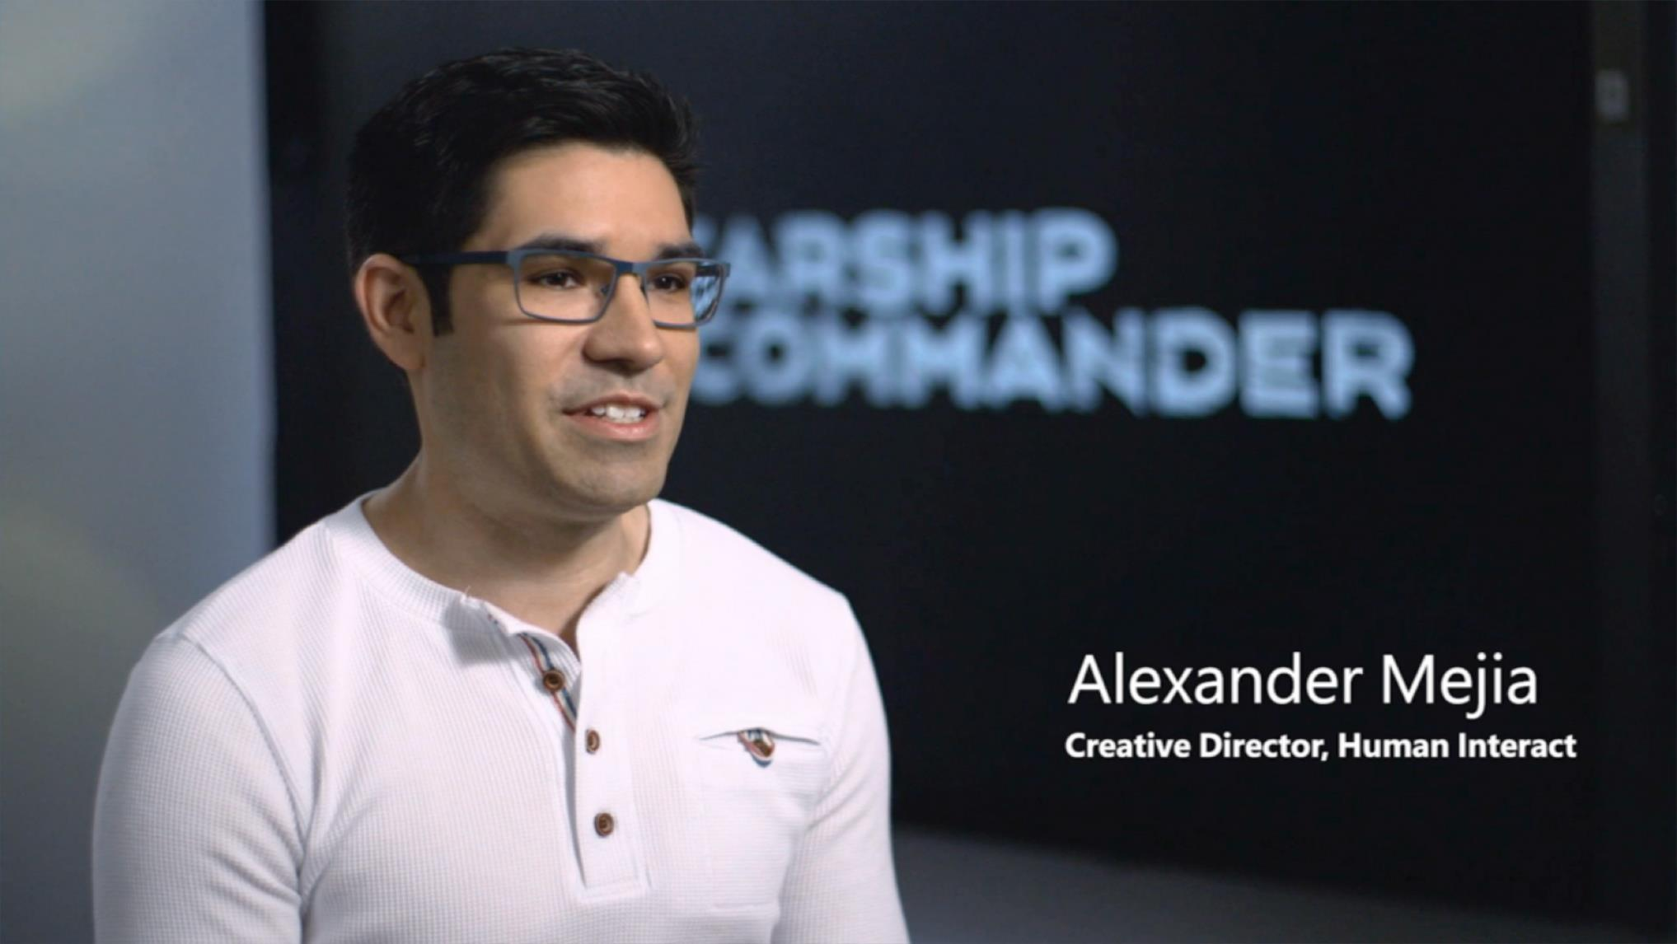
Notes:
Welcome to Starship Commander, a new virtual-reality (VR) game experience from Human Interact, a VR storytelling startup based in Champaign, Illinois. It’s the brainchild of VR storytellers Alexander Mejia and Adam Nydahl, who met at a VR game jam in 2015 and began developing the game together.
In the early builds of their game, Mejia and Nydahl used an open-source speech-recognition toolkit. However, it made too many errors, even in a completely quiet room.
Human Interact began to search for a more accurate speech-recognition platform. It initially eliminated cloud-based solutions because of dictionary problems. “We knew that the world we’re crafting would be full of fictional names and phrases most solutions wouldn’t understand,” Mejia says.
Then Human Interact learned about the Custom Speech Service (formerly CRIS). The Custom Speech Service is part of the Microsoft Cognitive Services collection, created by Microsoft Research to give developers the ability to tap into high-quality vision, speech, language, and knowledge deep-learning technologies with just a few lines of code.
The most amazing feature of the Custom Speech Service for Human Interact was the ability to train it with a custom script, which few speech APIs allow. “We were able to train the Custom Speech Service on keywords and phrases in our game, which greatly contributed to speech-recognition accuracy,” says Nydahl, Principal Artist at Human Interact. “The worst thing that can happen in the game is when a character responds with a line that has nothing to do with what the player just said. That’s the moment when the magic breaks down.”

Slide 26

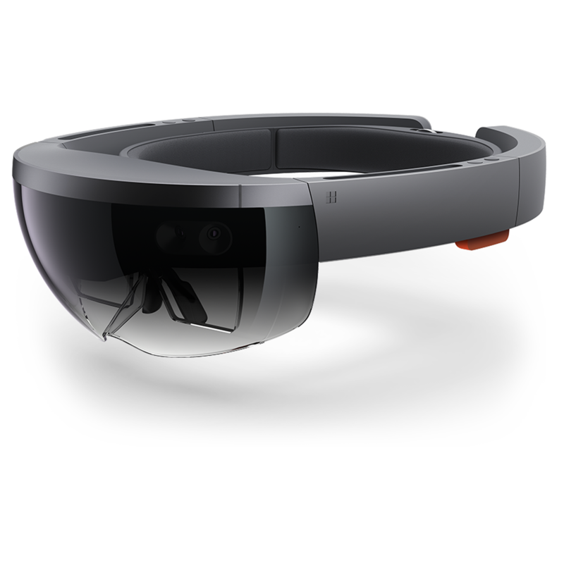
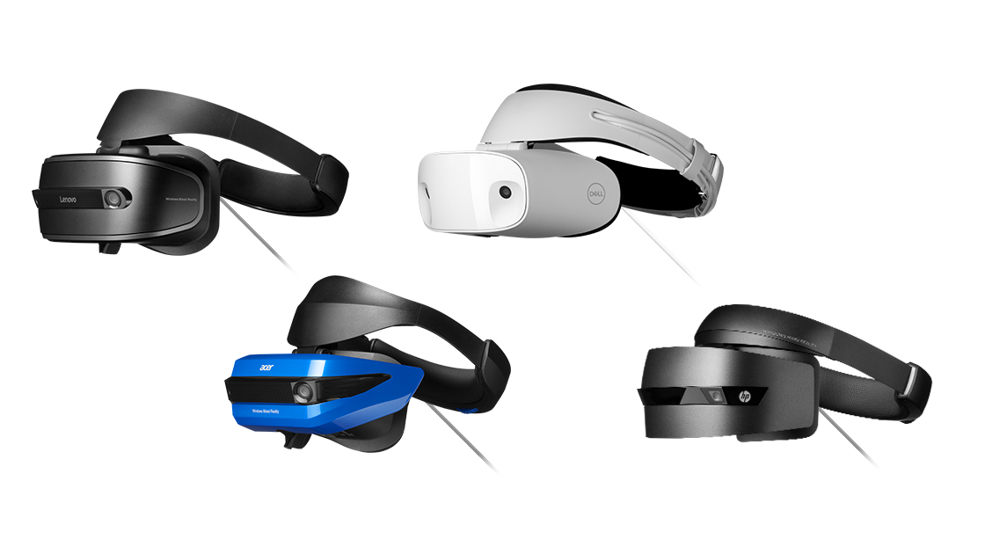
What is Mixed Reality?…
Physical Reality
Mixed Reality
Digital Reality
AR Today
VR Today
Holographic headsets (See-through)
Mixed Reality headsets (Opaque)
Notes:
Mixed Reality includes a variety of experiences
With Augmented Reality (AR) you can still see the physical world around you in addition to computer generated input which could include sound or graphics.
Microsoft HoloLens allows you to experience an Augmented Reality
With Digital Reality or Virtual Reality (VR) you are completely immersed in a virtual world. Iif you look up, down or around you all you see is the computer generated world like in the movie Ready Player One
Windows Mixed Reality Headsets allow you to experience a Virtual Reality and are manufactured by many vendors including HP, LeNovo and Samsung, ASUS, and more. Occulus Rift is also a VR headset

Slide 27



Mixed reality requires developers to handle new types of input
Voice allows you to directly command a hologram without having to use gestures. You simply gaze at a hologram and speak your command.
Gaze tells you where the user is looking in the world and lets you determine their intent.
Gesture input lets you interact with your holograms naturally using your hands or a clicker.
Game pads let you navigate, target, scroll, zoom, select.
Mouse and keyboard can point, click, or provide text input.
Notes:
Mixed reality does require handling new forms of input from users
Gaze is the first form of input and is a primary form of targeting within Hololens. Gaze tells you where the user is looking in the world and lets you determine their intent. In the real world, you'll typically look at an object that you intend to interact with.
Gestures allow users take action in mixed reality. HoloLens currently recognizes two core component gestures - Air tap and Bloom.
Voice input is used along with gesture as one of the two intention mechanisms. Both voice and gesture can be used with gaze to complete an interaction.
The big advantage of voice input is that it allows you to directly give a command without having to use gestures. You simply gaze at a hologram and speak your command, such as “Select” or something specific to your app. Many of the richest user experiences in MR in fact depend on voice. Azure services can help create a great voice interface.
Pre-read for speaker: https://developer.microsoft.com/en-us/windows/mixed-reality/gaze
Pre-read for speaker: https://developer.microsoft.com/en-us/windows/mixed-reality/gestures
Pre-read for speaker: https://developer.microsoft.com/en-us/windows/mixed-reality/voice_input
Pre-read for speaker: https://developer.microsoft.com/en-us/windows/mixed-reality/spatial_mapping
Pre-read for speaker: https://developer.microsoft.com/en-us/windows/mixed-reality/spatial_sound
Pre-read for speaker: https://developer.microsoft.com/en-us/windows/mixed-reality/coordinate_systems

Slide 28

Cognitive services can help you handle voice
Bing Speech API
Custom Speech Service
LUIS
Speaker Recognition API
Convert speech to text and back again.
Fine-tune speech recognition for anyone, anywhere
Build natural language into your apps that continuously improve
Give your app the ability to know who's talking
Notes:
Here’s just a taste of how Azure can help you in developing mixed reality applications. Cognitive Services provides a range of services that help you develop mixed reality apps that depend on voice input.
Bing Speech API Convert spoken audio to text. The API can be directed to turn on and recognize audio coming from the microphone in real-time, recognize audio coming from a different real-time audio source, or to recognize audio from within a file. In all cases, real-time streaming is available, so as the audio is being sent to the server, partial recognition results are also being returned https://azure.microsoft.com/en-us/services/cognitive-services/speech/
Custom Speech Service The Custom Speech Service enables you to create customized language models and acoustic models tailored to your application and your users. By uploading your specific speech and/or text data to the Custom Speech Service, you can create custom models that can be used in conjunction with Microsoft’s existing state-of-the-art speech models.
For example, if you’re adding voice interaction to a mobile phone, tablet or PC app, you can create a custom language model that can be combined with Microsoft’s acoustic model to create a speech-to-text endpoint designed especially for your app. If your application is designed for use in a particular environment or by a particular user population, you can also create and deploy a custom acoustic model with this service
https://docs.microsoft.com/en-us/azure/cognitive-services/custom-speech-service/cognitive-services-custom-speech-home
LUIS Designed to identify valuable information in conversations, LUIS interprets user goals (intents) and distills valuable information from sentences (entities), for a high quality, nuanced language model. LUIS integrates seamlessly with the Azure Bot Service, making it easy to create a sophisticated bot
https://www.luis.ai/home
Speaker Recognition API Speaker Recognition APIs are cloud-based APIs that provide the most advanced algorithms for speaker verification and speaker identification. Speaker Recognition can be divided into two categories: speaker verification and speaker identification.
https://docs.microsoft.com/en-us/azure/cognitive-services/speaker-recognition/home

Slide 29

Cognitive services can help you handle gesture
Project Gesture
Define and implement customized hand gestures
Notes:
There are also Cognitive services to help you recognize gestures
Project Gesture is a cutting-edge, easy-to-use SDK that creates more intuitive and natural experiences by allowing users to control and interact with technologies through hand gestures. Based on extensive research, it equips developers and UX designers with the ability to quickly design and implement customized hand gestures into their apps
https://labs.cognitive.microsoft.com/en-us/project-gesture

Slide 30
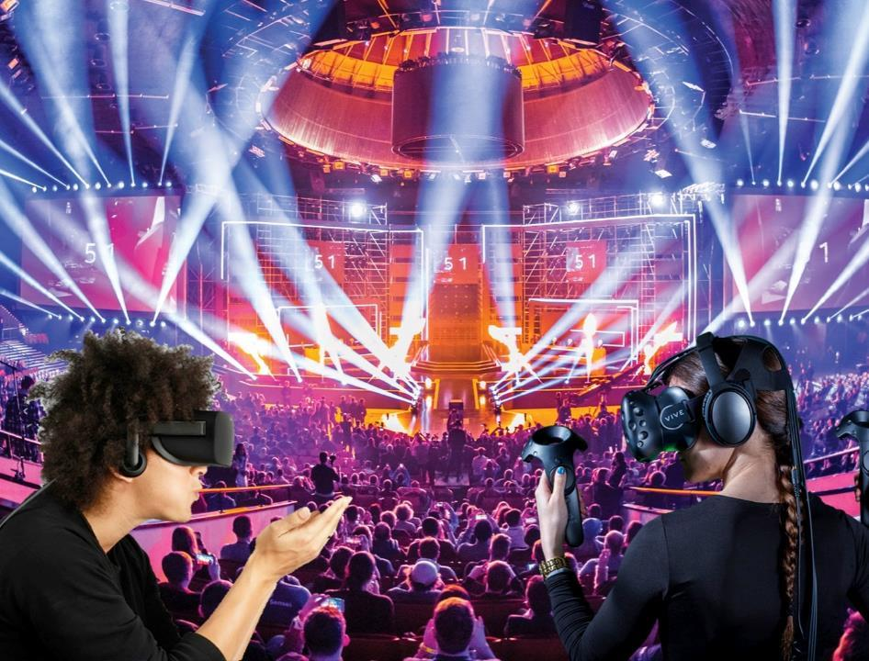

Mixed reality: what’s possible
Teleporter.tv: a social esports spectator platform based in virtual reality
Notes:
There are probably 2.6 Billion casual gamers in the world.
In addition to the gamers there are about 400 Million Esports viewers who watch teams and players compete live in video game tournaments.
Widespread broadband access has enabled new experiences and scenarios
Dilara is a Microsoft Student Partner in Turkey. She and her classmate Aslan are passionate gamers and eSports fans. But they realized that given where they lived it was unlikely they would ever have the opportunity to attend an eSports league event in person, they could only take part in the big eSports league events by livestreaming.
They came up with the idea of using VR headsets to give gamers a more immersive way of experiencing eSports league events.
Teleporter.tv was born. The concept was simple though not easy to build!
You set up 360 degree cameras and microphones around the eSports league venue and then generate a virtual experience for remote users far more immersive than what you get watching a livestream on your laptop.
They have also discovered that their users want to socialize and interact with the stream. So they are adding new functionality to their solution to enable two way interaction between users and gaming content creators!
They are also using Visual Studio and Visual Studio Code as a development environment. The front end and backend are written using mostly Typescript.
They currently support Occulus, HTC Vive and Windows Mixed Reality Headsets
But what’s really key is this solution could not exist without the cloud.
You have to capture the data from the cameras and microphones, process it, stitch it together and send it to the headset and you have to do it all in near real-time.
Teleporter uses VMs and streaming services on Microsoft Azure to bring it all to life!
Dilara and Aslan now work full time on their startup Teleporter
They are using their technical skills and the power of the cloud to pursue their passion!
http://teleporter.tv

Slide 31
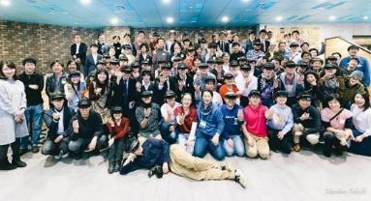
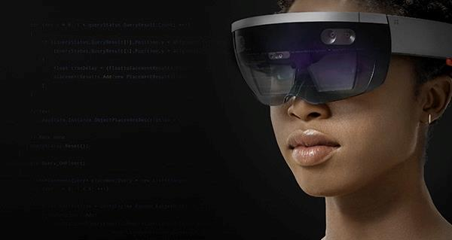
Interested in Mixed Reality?
Join the community:
aka.ms/mr
Notes:
If the potential of mixed reality is something that excites you, there’s a whole community out there willing to welcome you and help you get started with developing these apps of the future.

Slide 32

Justin Garrett
Director, Student Dev Evangelism
@justgar

Slide 33
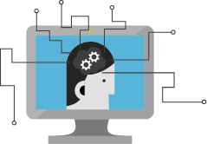
Azure: Your on-ramp to future trends
AI
Big Data
Mixed reality
Quantum Computing
Notes:
We’ve looked at Artificial Intelligence, Big Data and Mixed Reality.
Now let’s take a peek at the future – Quantum Computing

Slide 34
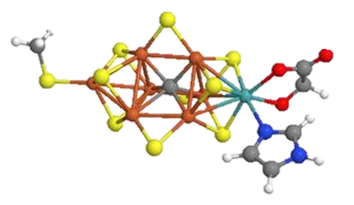

Quantum: Unprecedented computing power
Age of the universe
Binary
Computing
Calculation time
Quantum
Computing
Number of atoms
Notes:
Quantum computing holds the promise of solving many of today’s unsolvable problems. The availability of a scalable, general-purpose quantum computer will unlock incredible potential by helping answer questions that cannot be solved by today’s computers in a reasonable amount of time.
There is a classical problem called the RSA 2048 challenge which is basically about taking a very very large number and factoring it down to its prime numbers.
On a classical computer this would take 1 billion years to calculate on a quantum computer it would take 100 seconds!
What is Quantum computing?
It’s a new form of computing that goes exponentially beyond the capabilities of todays’ most powerful supercomputers.
It’s grounded in quantum mechanics at a subatomic level. How we store the information, how we process and compute the information is all based on Quantum mechanics
Today computers are based on transistors which are like a switch with two positions on or off, resulting in the binary 1 and 0 we know and love
As you need more compute power you have to add more 1s and 0s which means adding more and more transistors, but there are physical limitations to how small a transistor can be and how many we can fit in a space
Quantum computers operates differently, with what we call qubits
A qubit operates more like a dimmer switch because it can be ON, OFF or BOTH ON AND OFF at the same time. This is what they call a superposition state.
But it requires very specific conditions to operate such as extremely low temperatures.
We envision a future where you can go to a cloud provider like Microsoft Azure and spin up a Quantum computer as needed to tackle your biggest computing power needs

Slide 35



Quantum-focused programming language
Quantum Development Kit ^{Preview}
Local & Azure simulators
Sample code & libraries
Notes:
IF you want to explore the world of quantum today here are some great resources
Q# The first of its kind, Q# is a brand-new quantum-focused programming language with native type, operators, and other abstraction. Q# features rich integration with Visual Studio and VS Code and interoperability with the Python programming language. The enterprise-grade development tools give you the fastest path to quantum programming on Windows, macOS, or Linux
Local & Azure simulators Set breakpoints, step into the Q# code, debug line-by-line, and estimate the real-world costs to run your solution. Simulate quantum solutions requiring up to 30 qubits with a local simulator, or use the Azure simulator for large-scale quantum solutions requiring more than 40 qubits
Sample code and libraries Developed by top industry experts, a collection of ready-to-use building blocks take you from being a beginner to building your first quantum solution. The open source license allows development libraries and samples to be used in your applications, while also enabling you to contribute your own enhancements to the growing Q# community
Learn more https://www.microsoft.com/en-us/quantum/development-kit

Slide 36




Nitrogen
fixation
Carbon
capture
Materials
science
Machine learning
Notes:
Through quantum computing, we can unlock solutions to problems in areas such as artificial intelligence, clean energy, global warming, materials design, and much more.​
Searching for solutions to these problems, using say all of the world's classical computers operating together, would require time longer than the lifetime of the universe.
On a quantum computer, we can obtain the solution in just days or hours.
Take fertilizer. Now, I know "fertilizer" doesn't sound like the most exciting topic, but it directly impacts some of the biggest challenges facing our world, such as global hunger and clean energy. ​
Our current process was invented in the early 1900s, before we had the computational power of today! And it consumes around 3% of the world's natural gas.​
There's a mysterious process in nature by which certain microbes produce fertilizer more efficiently than our industrial approach ​
The quantum computer, working in concert with a classical supercomputer, could enable us to understand how these microbes perform this task in a matter of weeks or days, and then we can engineer our own more efficient catalysts.​
Using Classical computers, understanding this process requires millions of years

Slide 37


Slide 38
Azure:
A new world of possibility waiting for you
Notes:
Here’s a few tips and tricks to help you navigate the Azure Portal
https://azure.microsoft.com/en-in/blog/azure-portal-experience/

Slide 39
Linux
Python
Java
node.js
Docker
Android
And many more …
With Azure, you have choices
40%
of Azure VMs run Linux⁴
Notes:
When you’re looking at cloud platforms, the first thing you want to make sure about—understandably—is whether you can build with your preferred tools and languages on your device. In other words, it needs to be an open platform.
So let’s make sure one thing is clear: Azure is open. You can run any stack, whether it’s Linux operating system (OS)–based or Windows OS–based. In fact, about one-third of Azure virtual machines (VMs) specifically run Linux. You can also use open-source tools like a Kubernetes cluster in Azure Container Service. And Azure supports Docker too, of course. And GitHub platform–based DevOps. And more.
Web app in Java
Android app using Azure App Service
Xamarin app with C# targeting 3+ platforms
Data science Linux VM
Apps with TensorFlow and similar
You have choices. Choices that help you maximize your existing investments. Get support for infrastructure as a service (IaaS) on Linux, Java, and PHP or node.js application platforms. Develop and test your Linux and open-source components in Azure. You bring the tools you love and skills you already have, and you run virtually any application using your data source, with your operating system, on your device.
⁴ ZDNet. “Microsoft says 40 percent of all VMs now are running Linux.” October 2017. www.zdnet.com/article/microsoft-says-40-percent-of-all-vms-in-azure-now-are-running-linux/.

Slide 40



Azure for Students
+
Verify as a student
$100 annual credit
25+ free products
Pay nothing
No credit card required
Ability to convert to pay-as-you-go
for 12 months or until $100 credit is used
aka.ms/azure4students
Notes:
Finally, we recently announced a new way for students to get Azure for free.
Now you can get $100 of credit plus a free-tier of Azure products to use in today’s challenges, your own apps, in your university courses, and potentially in Imagine Cup, too. The free tier includes AI capabilities like Computer Vision and Azure Machine Learning, in addition to VMs to build your own solutions.
Learn more at http://aka.ms/azure4students

Slide 41

Team up. Use your creativity, your passion, and your knowledge of technology to create applications that shape how we live, work, and play.
Microsoft's premier student technology competition
imagine.microsoft.com/usa
Notes:
Cloud with big data, AI, and mixed reality—these are the technologies of the future.
Consider building a solution using these technologies and entering it the Imagine Cup.
Imagine Cup is a global competition for students. Use your creativity, passion, and knowledge of technology to create applications that shape how we live, work, and play. Every year, tens of thousands of students from across the globe compete for cash, travel, and prizes and for the honor of taking home the Imagine Cup!
You can win up to $100,000 and a mentoring session with Microsoft CEO, Satya Nadella.
Register online and find official rules at https://imagine.microsoft.com/.

Slide 42
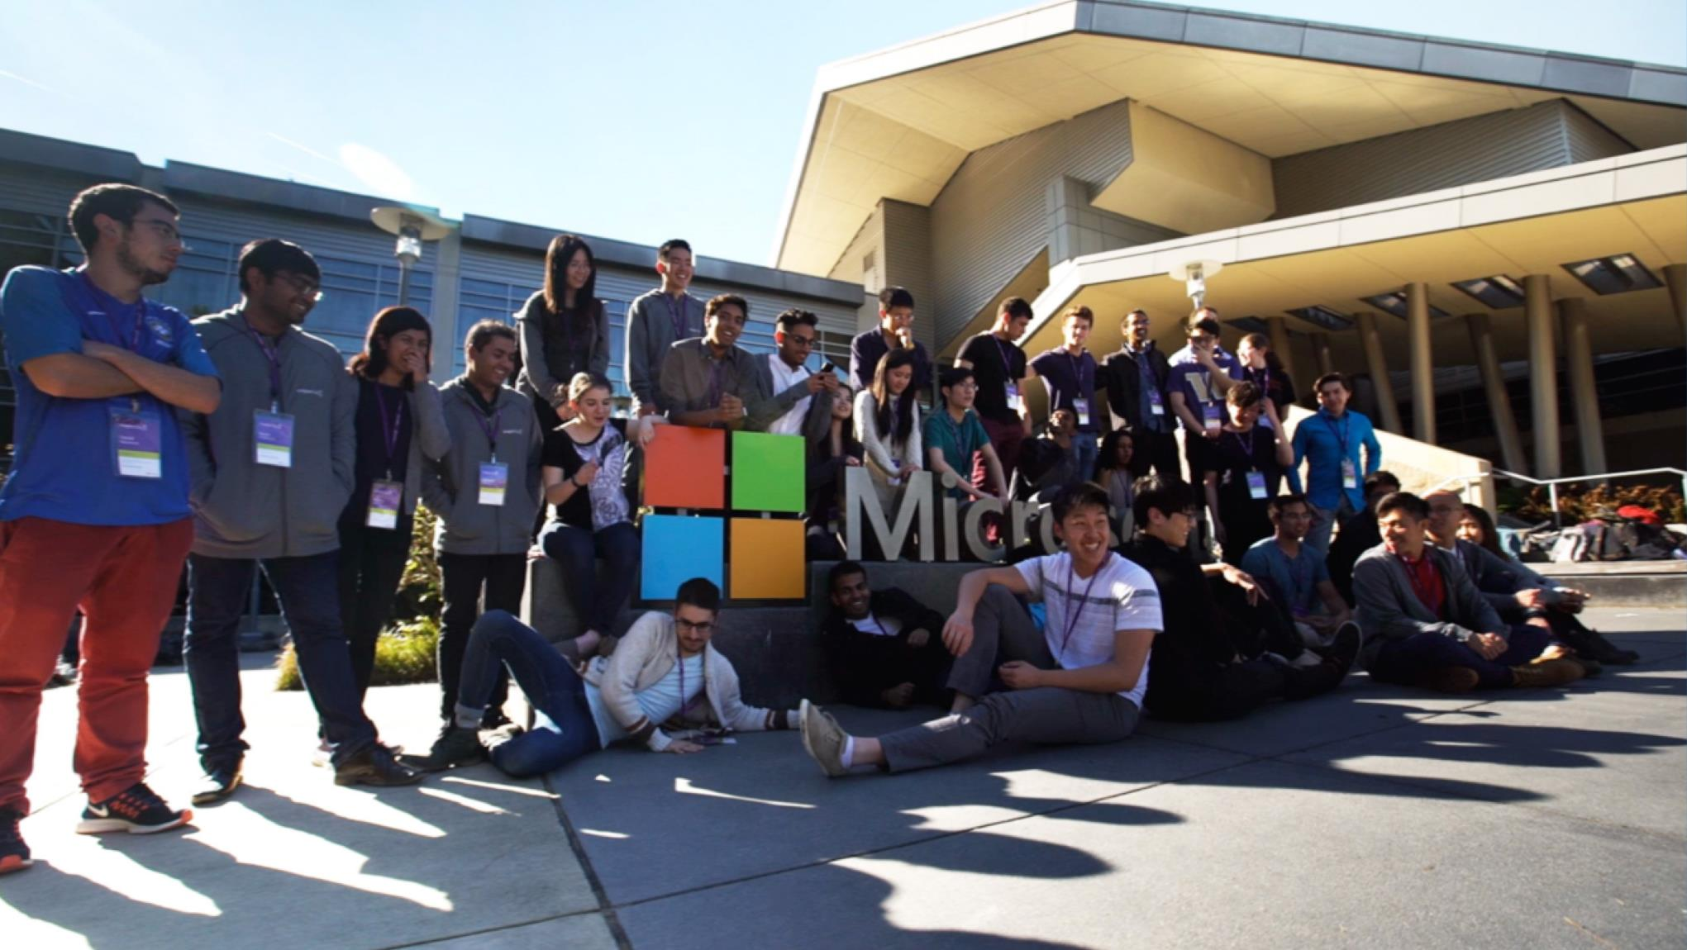
Notes:
Code with purpose!

Slide 43
Take your pick of today’s hands-on lab challenges:
Big data
AI
Machine learning
aka.ms/AzureUniversityTour (link to labs) aka.ms/azure4students (need Azure?)
Notes:
aka.ms/AzureUniversityTour
For our BnB application we ahd to start by collecting the data from open Data sources and then pulling the data we needed from the files
In the Big Data lab challenge you will learn how to use Azure Data Lake and U-SQL to clean up and query data and to gain insights into your data
Next in our BNB application we customized search results to help renters find the perfect neighborhood
In the AI lab challenge Discover the power of Microsoft Cognitive Services. In this challenge, you use Microsoft Cognitive Services Project Local Insights within a Node.js web application to help identify the best neighborhood based on user preferences. Location ranking is determined based on what you can find nearby: public transit? A coffee shop? Your website will allow the user to set weights to different attributes, personalizing the search. Next, you use Project Local Insights to group and weigh these attributes and narrow down your search.
Our BNB app also helped renters determine the optimum rental rate for their property
In the Machine Learning lab, you take advantage of the Data Science Virtual Machine (DSVM). This VM comes pre-loaded with everything you need to train your own model and use Azure notebooks to run Python code to train predictive models and determined the optimum rental rate.

Slide 44
Endnotes
¹ LinkedIn. “LinkedIn Data Reveals the Most Promising Jobs and In-Demand Skills of 2018.” January 2018. https://blog.linkedin.com/2018/january/11/linkedin-data-reveals-the-most-promising-jobs-and-in-demand-skills-2018.
² Glassdoor. “Data Scientist Salaries.” March 2018. www.glassdoor.com/Salaries/data-scientist-salary-SRCH_KO0,14.htm.
³ Paysa. “Artificial Intelligence Engineer Salaries.” www.paysa.com/salaries/artificial-intelligence-engineer--t.
⁴ ZDNet. “Microsoft says 40 percent of all VMs now are running Linux.” October 2017. www.zdnet.com/article/microsoft-says-40-percent-of-all-vms-in-azure-now-are-running-linux/.
⁵ Microsoft. “Confidence in the trusted cloud.” https://azure.microsoft.com/en-us/overview/trusted-cloud/.
⁶ Microsoft. “Introducing Azure Availability Zones for resiliency and high availability.” September 2017. https://azure.microsoft.com/en-us/blog/introducing-azure-availability-zones-for-resiliency-and-high-availability/.
⁷ Microsoft. “Artificial Intelligence – Getting Started with Microsoft AI.” 2017. https://msdn.microsoft.com/en-us/magazine/mt814801.aspx.

